Slide 1




Azure Basics for the DBA
John Morehouse
Consultant
Denny Cherry & Associates Consulting
john@dcac.co
http://linkedin.com/in/sqlrus
@SqlRUs
http://www.sqlrus.com

Slide 2
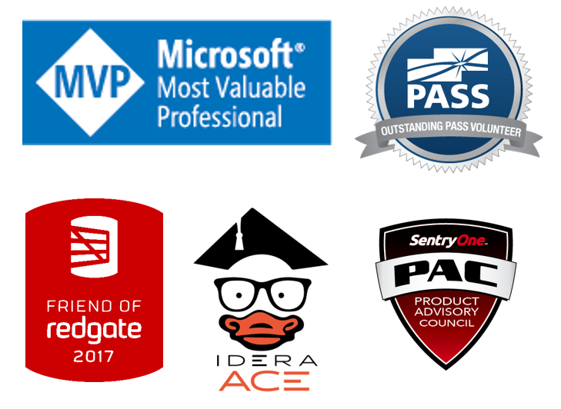
Who Am I?
Leader of the Louisville SQL Server/Power BI User Group
Organizer/Speaker of SQL Saturday’s & other conferences
Heavily involved with SQL PASS
Microsoft Data Platform MVP
Friend of Redgate 2015 - 2018
Idera ACE 2016
SentryOne Product Advisory Council

Slide 3

The vetted and certified experts at Denny Cherry and Associates Consulting assist companies with attaining IT goals such as HA, scalability, SQL Server virtualization, migration, and acceleration reliably while finding ways to save on costs. With clients ranging from Fortune 50 corporations to small businesses, their commitment to each is the same: to provide a deft, high-speed IT environment that leverages every aspect of their platform: from network, architecture, to infrastructure.
Visit DCAC at http://www.dcac.co

Slide 4

Quick Check
How many:
DBA’s
Developers
BI/DWH
Other
Please make sure to fill out evaluations
Ask questions!!!

Slide 5
Agenda
The Cloud
Terminology
Geographies/Regions
Networking
Data Security
Azure Virtual Machines
SQL DB
Managed Instances (MI)
Demos

Slide 6
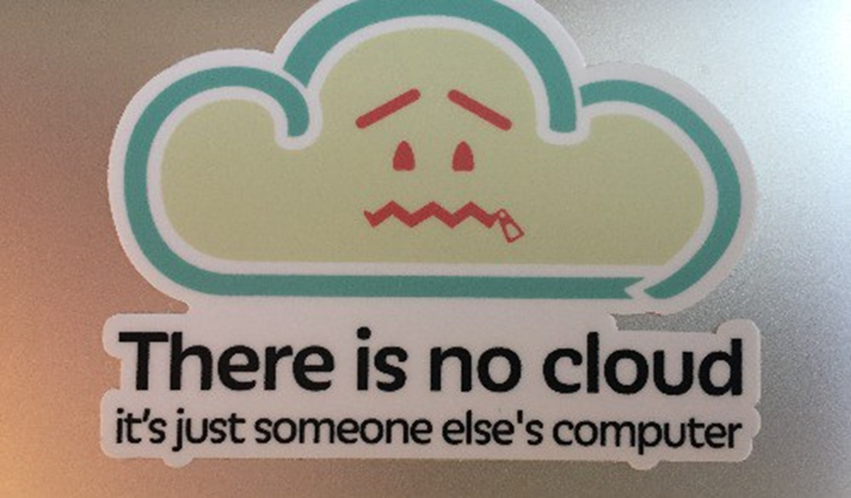
The Cloud

Slide 7


Terminology
“On Prem”
IaaS – Infrastructure as a Services
PaaS – Platform as a Service
SaaS – Software as a Service
AAD – Azure Active Directory
ARM – Azure Resource Manager
LRS/GRS/ZRS/RA-GRS
Resource Groups
Geographies/Regions
Notes:
Locally Redundant Storage – redundant storage within the same data center
Geo-redundant Storage – geo0redundant storage across geo-graphics regsions
Zone-redundant Storage – redundant storage across zones
Read-access geo-redundant Storage -
Regions not data centers

Slide 8
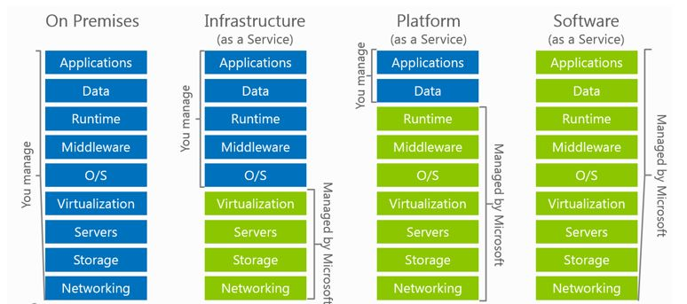
Terminology
Notes:
Use spectre/meltdown as an example.
On premises - install the patch, reboot, fail over whatever.
IaaS vs PaaS - You’d see a blip as the underlying hardware is rebooted

Slide 9
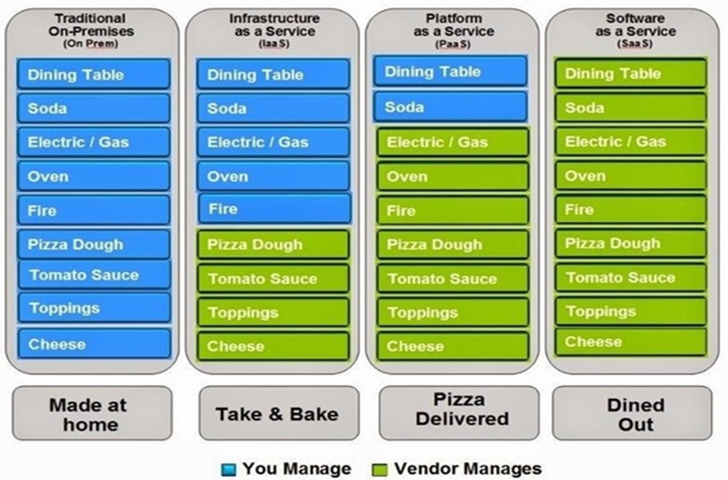
Pizza as a Service

Slide 10
Geographies/Regions
Region 1
The world is divided into geographies
Defined by geo-political boundaries or country borders
Defines the data residency boundary for customer data
A region is defined by a bandwidth and latency envelope
<2ms latency diameter (round trip)
Customers see regions, not DCs
Different fault and flood zones, electrical grid, hurricane zone
Typically hundreds of miles apart
100’s of miles
Region 2
Notes:
https://azure.microsoft.com/en-us/global-infrastructure/regions/

Slide 11
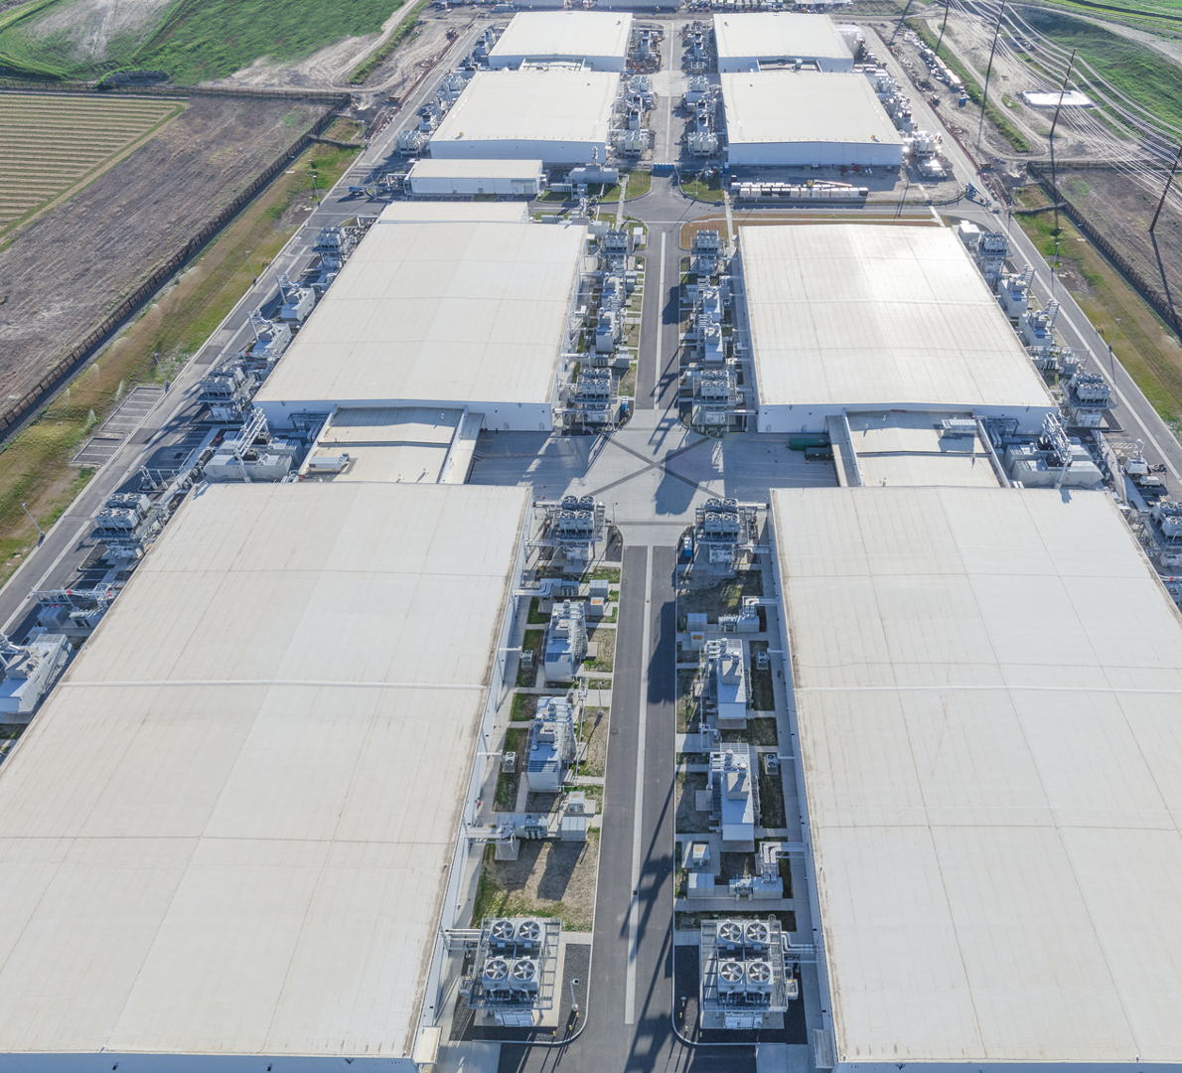
Quincy, WA

Slide 12
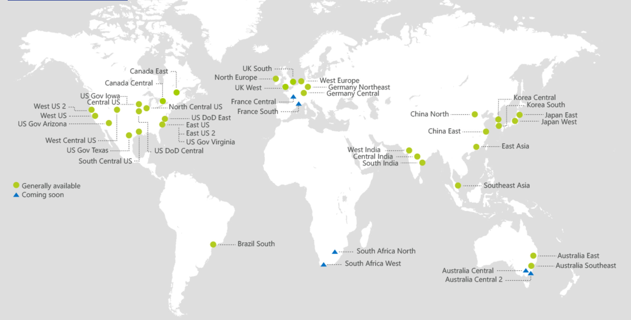
Regions

Slide 13
Networking
Azure
Virtual Network
Users
Internet
Front-End Access
Dynamic/Reserved Public IP addresses
Direct VM access, ACLs for security
Load balancing
DNS services: hosting, traffic management
DDoS protection
Backend Connectivity
ExpressRoute
VPN Gateways
Notes:
Let’s talk about the big networking picture.
Virtual network: An Azure virtual network (VNet) is a representation of your own network in the cloud.
Bring your own network: Microsoft lets you bring you own network (BYON) into Windows Azure. You can connect your local area network (LAN) to Azure and an unlimited number of computers on your corporate networks can seamlessly communicate with VMs in Azure. You can specify private network spaces (such as 192.168.x.x and 10.x.x.x) in any range, size, and starting number to suit your existing network topology.
Segment with subnets and security groups: You can also further segment your VNet into subnets and deploy Azure IaaS virtual machines (VMs) and PaaS role instances, in the same way you can deploy physical and virtual machines to your on-premises datacenter. Network Security Groups provide control over network traffic flowing in and out of your services running in Azure.
Control traffic flow with User Defined Routes: With user defined routes, you now have complete control over the traffic flow in your virtual network. Virtual network by default provides system routes for traffic flow between virtual machines. You can now customize the routing table by defining routes allowing you to direct traffic through network appliances.
<Click>
Front-End Access: for the front end access, Microsoft Azure Virtual Private Network (VPN) provides multiple options to secure and manage VPN like, dynamic/reserved public IP address, ACL for security, load balancing etc…
<Click>
Backend Connectivity: With Microsoft Azure Virtual Private Network (VPN), you can create point-to-site VPN for your dev/test, create secure site-to-site connectivity with Azure VPN gateways and can opt for ExpressRoute for private enterprise grade connectivity.

Slide 14
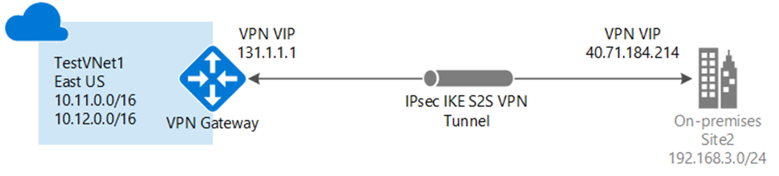
Networking
Virtual Network
“Bring Your Own Network”
Segment with subnets and security groups
Control traffic flow with User Defined Routes
Backend Connectivity
Point-to-site for dev / test
VPN Gateways for secure site-to-site connectivity
ExpressRoute for private enterprise grade connectivity
Notes:
Let’s talk about the big networking picture.
Virtual network: An Azure virtual network (VNet) is a representation of your own network in the cloud.
Bring your own network: Microsoft lets you bring you own network (BYON) into Windows Azure. You can connect your local area network (LAN) to Azure and an unlimited number of computers on your corporate networks can seamlessly communicate with VMs in Azure. You can specify private network spaces (such as 192.168.x.x and 10.x.x.x) in any range, size, and starting number to suit your existing network topology.
Segment with subnets and security groups: You can also further segment your VNet into subnets and deploy Azure IaaS virtual machines (VMs) and PaaS role instances, in the same way you can deploy physical and virtual machines to your on-premises datacenter. Network Security Groups provide control over network traffic flowing in and out of your services running in Azure.
Control traffic flow with User Defined Routes: With user defined routes, you now have complete control over the traffic flow in your virtual network. Virtual network by default provides system routes for traffic flow between virtual machines. You can now customize the routing table by defining routes allowing you to direct traffic through network appliances.
<Click>
Front-End Access: for the front end access, Microsoft Azure Virtual Private Network (VPN) provides multiple options to secure and manage VPN like, dynamic/reserved public IP address, ACL for security, load balancing etc…
<Click>
Backend Connectivity: With Microsoft Azure Virtual Private Network (VPN), you can create point-to-site VPN for your dev/test, create secure site-to-site connectivity with Azure VPN gateways and can opt for ExpressRoute for private enterprise grade connectivity.

Slide 15

Data Security
Transport Lay Security (TLS)
Transparent Data Encryption (TDE)
Always Encrypted
Row-level security
Dynamic Data Masking
Authentication
SQL Authentication
Azure Active Directory Authentication

Slide 16

Azure Virtual Machines
VM hosted on Microsoft Azure Infrastructure (“IaaS”)
Fast provisioning (~15 minutes). Provision groups of servers with resource templates
Accessible via RDP and Powershell
Pay per use
Per minute (only when running)
Cost depends on size and licensing
EA customers can use existing SQL licenses (BYOL)
Network: only outgoing (not incoming)
Storage: only used (not allocated)
Elasticity
Grow as needed
Notes:
1 core / 2 GB mem / 1 TB ← → 32 cores / 448 GB mem / 64 TB
From Microsoft images (gallery) or your own images (custom)
SQL 2008R2 / 2012 / 2014 / 2016 / 2017
Web / Standard / Enterprise
Images refreshed with latest version, SP, CU
SQL Server on Linux
EA = Enterprise Agreement

Slide 17
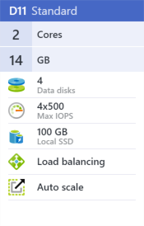
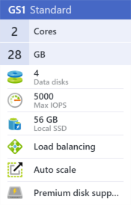
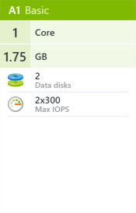
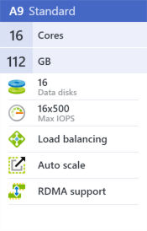
Azure Virtual Machines
VM size determines compute capacity
# of cores, RAM, # of disks, local SSD
VM size determines features
Auto-scale, load balancing, RDMA, Premium storage support
Notes:
Different Storage Options
Standard Storage: Low throughput (max 500 IOPs p/disk)
High latency (avg 40ms), pay for used space
Premium Storage: High throughput (max 7500 IOPs p/disk)
Low latency (avg 4ms), pay for allocated space
https://docs.microsoft.com/en-us/azure/virtual-machines/windows/sizes

Slide 18
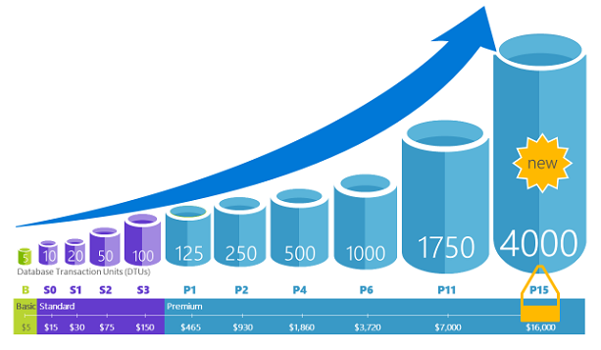
SQL DB
Just a database in the cloud
Sized differently than VMs
Different Size Labels
Database Transaction Unit (DTU)
https://sqlperformance.com/2017/03/azure/what-the-heck-is-a-dtu
Vcore licensing
Notes:
DTU – Database Transation Unit

Slide 19
SQL DB
No physical access to database files
No need to upgrade
No need to patch
No need to reboot/restart
Automatic backups (yay!)
TDE Enabled by default
Things get tested here first

Slide 20
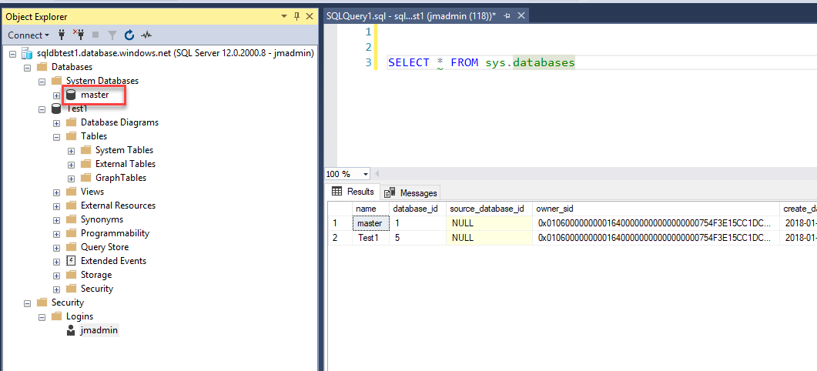
SQL DB

Slide 21
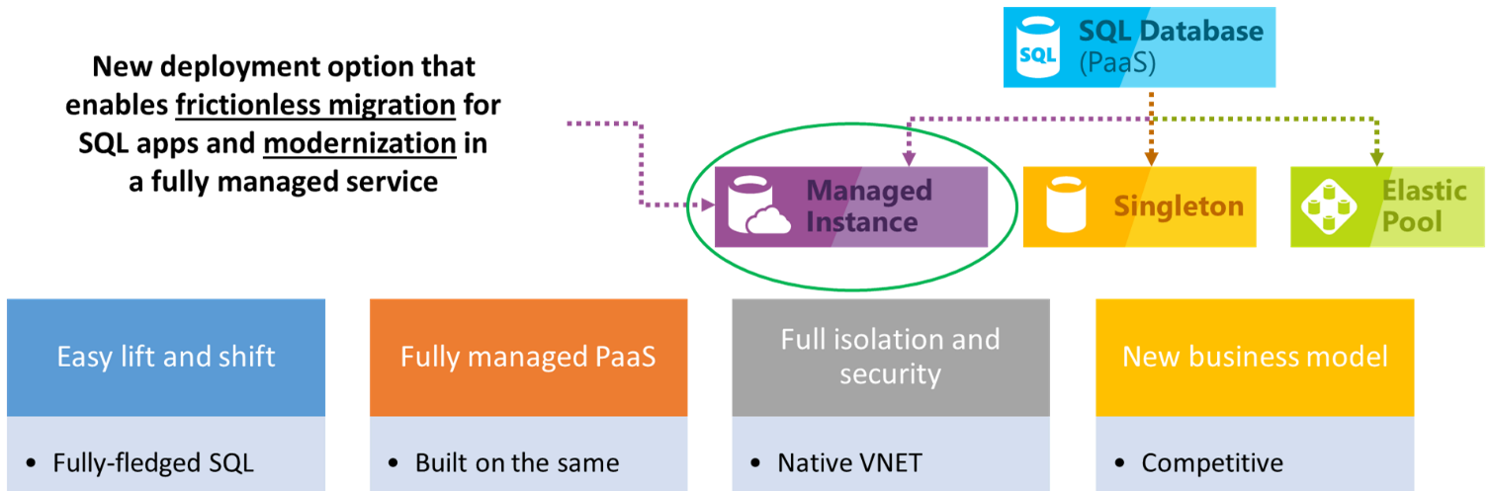
Managed Instances (MI)

Slide 22
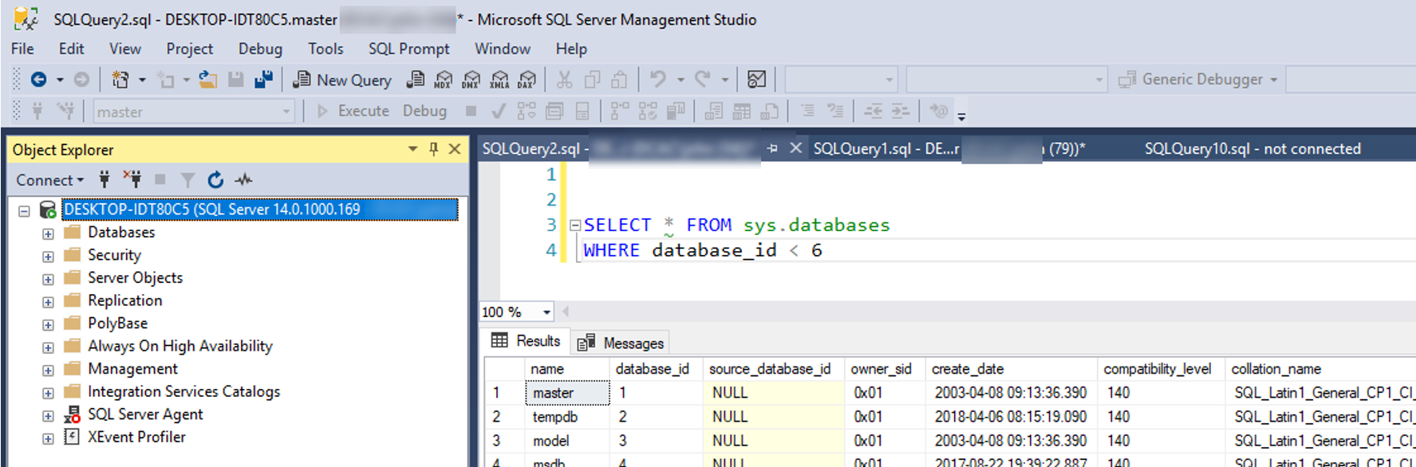
It really looks like…

Slide 23
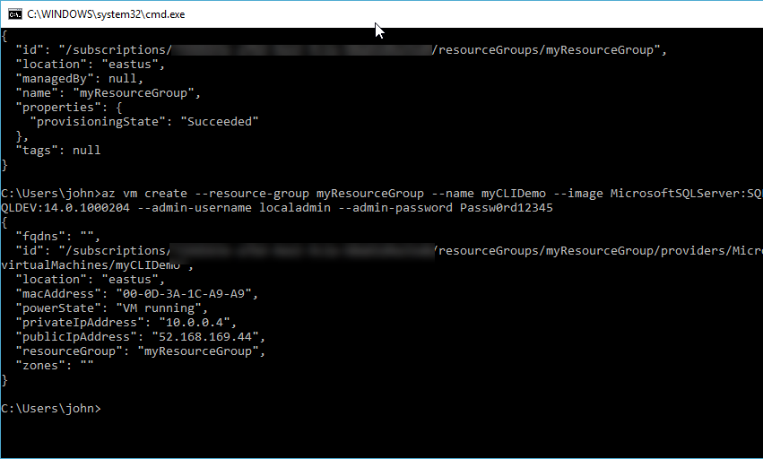
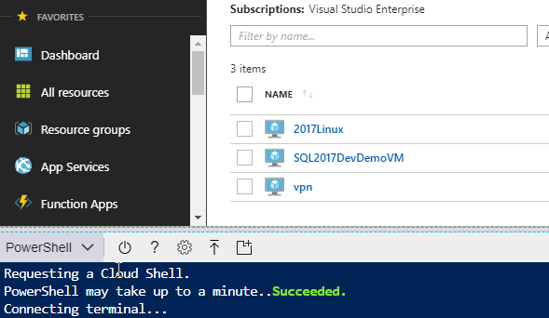
Command Line
Powershell
Locally
Azure Powershell (Cloud Shell)
Azure Command Line Interface (CLI)

Slide 24

Demo
Configuring a virtual machine (VM)
Configuring SQL DB
Powershell/Azure CLI

Slide 25
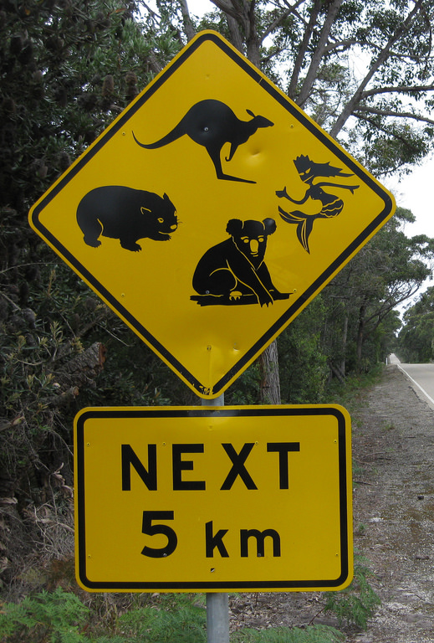
Gotchas
VMs
Auto shut off
Storage – Spinning vs SSD
$$$$
SQL DB
Where are the backups?
Ronco – Set it, Forget it
Notes:
Mention the cost differences between spinning and SSDs

Slide 26
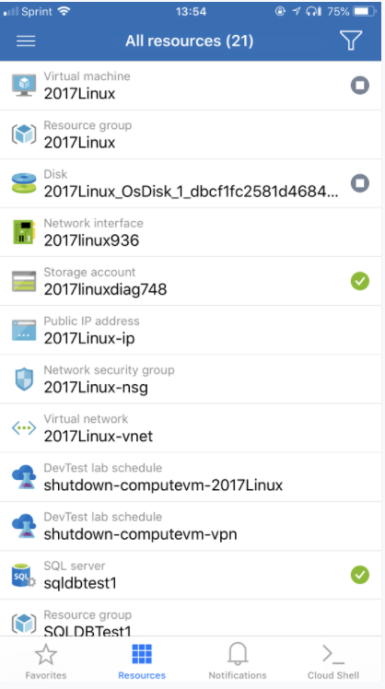
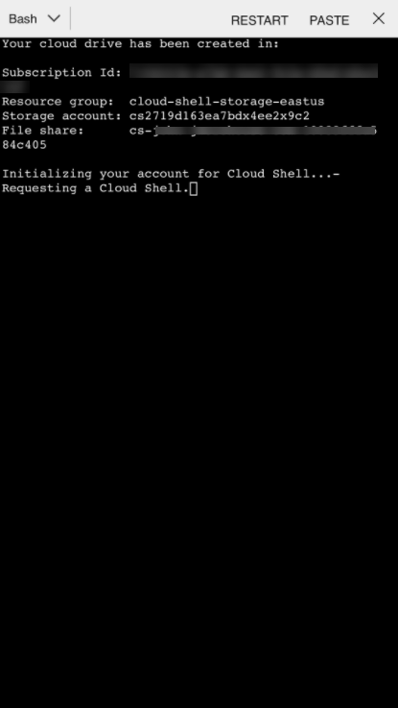
Mobile Capabilities
Start/Stop VMs
BASH Scripts
PoSH Coming

Slide 27

Getting Started
Free trial
//azure.com/free
12 months of
Compute
Storage
Network
Database
Always free access to 25+ services including app service and functions
$200 US credit to try it out within 30 days

Slide 28
Resources
Azure CLI
https://docs.microsoft.com/en-us/cli/azure/?view=azure-cli-latest
Azure PowerShell
https://docs.microsoft.com/en-us/powershell/azure/overview?view=azurermps-5.6.0
Storage Replication
https://docs.microsoft.com/en-us/azure/storage/common/storage-redundancy
Windows VM Sizes
https://docs.microsoft.com/en-us/azure/virtual-machines/windows/sizes
PaaS vs IaaS
https://docs.microsoft.com/en-us/azure/sql-database/sql-database-paas-vs-sql-server-iaas
Azure SQL DB DTU Resource Limits
https://docs.microsoft.com/en-us/azure/sql-database/sql-database-dtu-resource-limits
Azure SQL DB Service Tiers
https://docs.microsoft.com/en-us/azure/sql-database/sql-database-service-tiers

Slide 29

Questions

Slide 30
SQL Summit
Annual International Conference
November 6 -9 | Seattle, WA
2 Days of Pre-Cons
200+ sessions over 3 days
Over 5,000 SQL Professionals
Evening Networking Activities
Discount Code: SSDISODNS

Slide 31
THANK YOU!!!!
john@dcac.co
http://linkedin.com/in/sqlrus
@SqlRUs
http://www.sqlrus.com

